Slide 1
Microarray Technology
Production, Use, and Analysis: A Presentation
Nabil Azamy, Kevin Brown, Nicholas Shefte

Slide 2
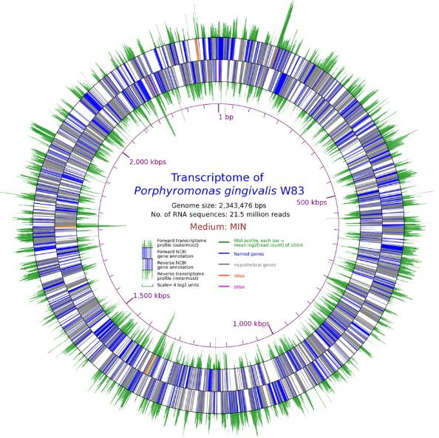
DNA Expression
Bacteriol. January 2012 vol. 194 no. 1 100-114

Slide 3
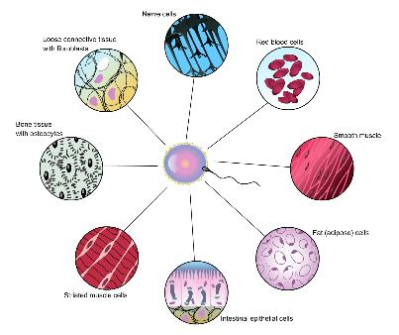
Differentiation
Differentiated cell types show distinct expression patterns
Humans have as many as 220 different cell types
Each with differing roles
Disease state phenotypes may often be limited to specific cell types

Slide 4
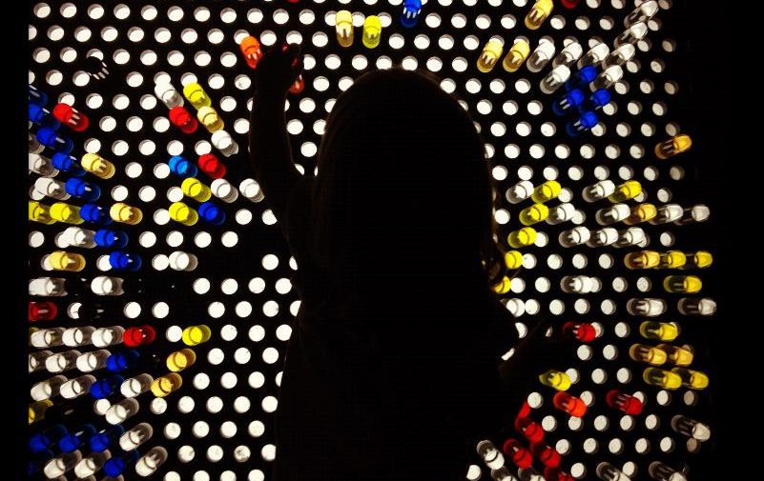
Microarrays

Slide 5
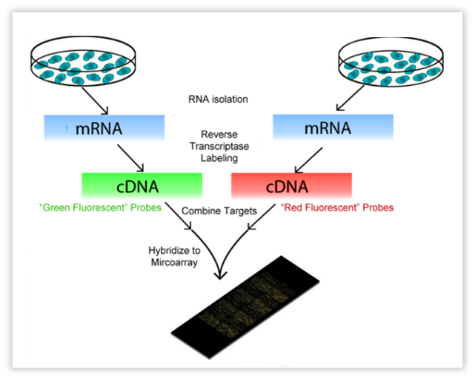
Microarray Workflow

Slide 6
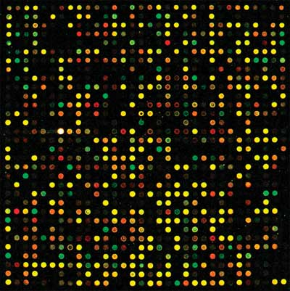
Sample Detection
Multiple fluorescently labeled DNA samples hybridize to oligo lawn
Hybridized strands compete with others producing a blended emission signal
Intensities allow for measurement of abundance of each sample within each spot
M = log₂ R/G
A = log₂ √(R•G)

Slide 7
Analysis Challenges
Noise can make normalization difficult
Noise sources
Point mutations
Splice variants
Transgenic species
Dye handling
True positives validated against PCR
Unknown unknowns can be difficult to detect

Slide 8
Application
Designed for GenePix two-channel microarray scanner GPR data files
Assists in post-normalization of pre-filtered patient data
Provides outlier detection using:
Mean vs Coefficient of Variation plots
Application runtime:
O(m*n), where:
m = number of files to be read
n = number of spots within the array
O(m*nlogn)
Following the quicksort runtime when calculating file metrics
Means standard deviation, coefficient of variation, minima, maxima, and median values

